Slide 1
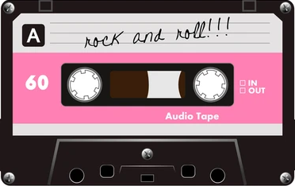
Save Your Listens
Zachary, Aaron, Josh

Slide 2

Description
Description & Motive
The Save Your Listens page (SYL) is a web page where users can enter a song they listened to recently and want to share their thoughts on. The page will let users save notes and ratings of these songs, along with the songs information so that they can share their musical taste with others.
Motive: Music taste is really personal to us as a society. It can be hard to really show someone the depth of your understanding and connection with music. Our goal is to have our users share, reference, and explain their taste through our webpage.
Target Users: This project is designed for anyone who enjoys music. From avid audiophiles to casual car-radio listeners, this page is for all ages and demographics. Most users will likely share with their friends and family, so the user-base should expand quickly as well

Slide 3
Description
Function & Tasks
Zach: will be responsible for handling the database functions and formatting, and making sure that all information that needs to be retrieved, can be, and that all information that needs to be added, can be.
Josh: will focus on the actual page design format and UI, making it look nice, while being functional.
Aaron: will focus on connecting the database functions to the actual page, and implementing an embed page that can be referenced on other sites.
Context: The SYL page would function as its own website where users have their own page that they can add songs to, and would have embeddable capabilities as well, to show a user’s top 5 songs, or other preset metrics. Places that users may wish to embed could be social media platforms (like instagram, or twitter) or a personal blog page.

Slide 4
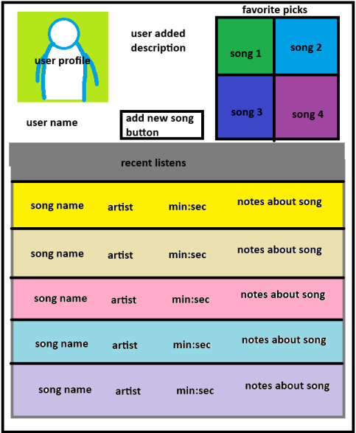
Description
Sketch layout

Slide 5
Description
Thank you / Q&A

